Slide 1
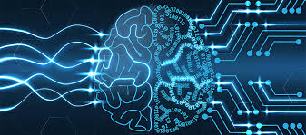
DEEP LEARNING

Slide 2
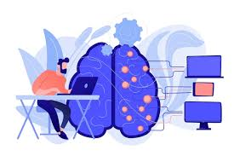
Deep learning is a type of machine learning that uses big, complex models to help computers learn from lots of data. It's like teaching a computer to think in layers, much like how our brain works, to understand patterns, images, or sounds.

Slide 3
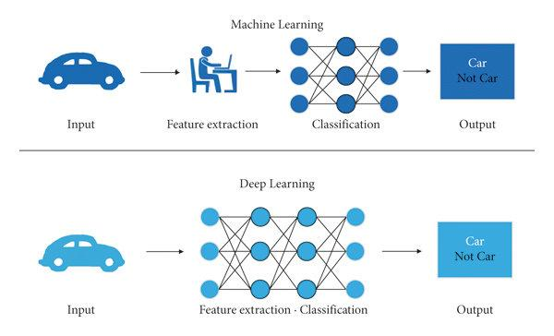

Slide 4
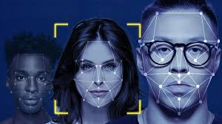
WHAT DOES IT DO?
IMAGE RECOGNITION
Deep learning helps computers recognize objects in pictures.
Example: When Facebook automatically tags your friends in photos, it’s using deep learning to recognize their faces.

Slide 5
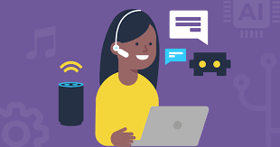
VOICE ASSISTANCE
Deep learning helps voice assistants like Siri or Alexa understand what you’re saying.
Example: When you ask Alexa to play a song, it understands your voice and requests, thanks to deep learning.

Slide 6
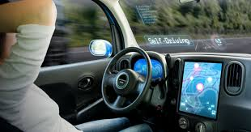
SELF DRIVING CARS
Deep learning helps self-driving cars "see" the road and make decisions.
Example: A self-driving car uses deep learning to recognize traffic signs, pedestrians, and other cars to drive safely.

Slide 7
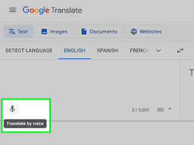
SPEECH TRANSLATION
Deep learning helps translate spoken words from one language to another.
Example: Google Translate can listen to someone speaking in one language and translate it into another in real-time.

Slide 8
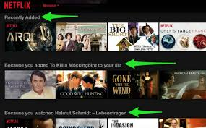
RECOMMENDATIONS
Deep learning helps platforms like Netflix or Spotify recommend movies or music based on what you like.
Example: If you often watch action movies, Netflix uses deep learning to suggest similar films you might enjoy.

Slide 9
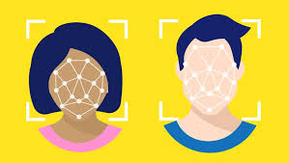
TYPES OF DEEP LEARNING
Convolutional Neural Networks (CNNs):
Used for: Image recognition and processing.
How it works: CNNs look at small parts of an image at a time (like zooming in) to understand patterns like edges, shapes, and colors, then combine that to recognize the whole picture.
Example: Used in facial recognition or self-driving cars to recognize objects on the road.

Slide 10
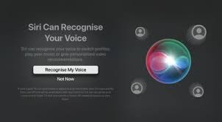
Recurrent Neural Networks (RNNs):
Used for: Working with data that has a sequence, like text, speech, or time-based data.
How it works: RNNs remember information from earlier in the sequence to make better decisions later (kind of like remembering the beginning of a sentence to understand the whole sentence).
Example: Used in voice assistants (like Siri or Alexa) to understand spoken words and respond.

Slide 11
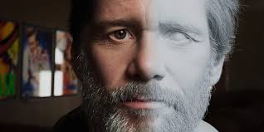
Generative Adversarial Networks (GANs):
Used for: Creating new, realistic images, videos, or sounds.
How it works: GANs have two parts: one creates new images, and the other tries to tell if the image is real or fake. They work together until the created images look real.
Example: Used to generate realistic pictures of people who don’t actually exist or in art creation.

Slide 12
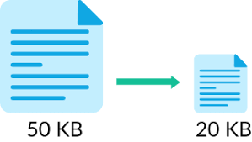
Autoencoders:
Used for: Reducing the size of data or learning to create new data.
How it works: Autoencoders learn to compress information (like making a smaller file) and then recreate it back to its original form, which helps to remove noise or errors from data.
Example: Used in image compression or cleaning up noisy photos.

Slide 13
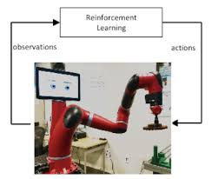
Deep Reinforcement Learning:
Used for: Teaching models to make decisions through trial and error.
How it works: The model learns by trying actions and getting rewards or penalties, similar to how a video game character gets better over time.
Example: Used in robots or self-driving cars to learn how to navigate or make decisions.

